Slide 1
IP Addresses

Slide 2
Topics
Anatomy of an IP address
IP Address Classes
Special IP Addresses
Gateway
DNS
NAT

Slide 3
Anatomy of an IP address
IPv4 address is a 32 bit binary number
Ex: 192.168.0.1
11000000101010000000000000000001
Quad Dotted Decimal notation is used to make it human readable
Each IP address has two parts
Network portion
Host Portion
EX: 192.168.0 is the network portion of the above IP
.1 is the host portion
Subnet Mask is used to determine what portion is network and which is host

Slide 4
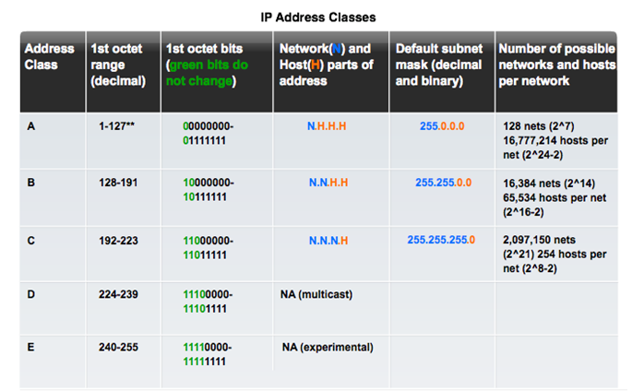

Slide 5
Special IP Addresses
Private address blocks are
Hosts that do not require access to the Internet can use private addresses
10.0.0.0 to 10.255.255.255 (10.0.0.0/8)
172.16.0.0 to 172.31.255.255 (172.16.0.0/12)
192.168.0.0 to 192.168.255.255 (192.168.0.0/16)
Network and Broadcast addresses – within each network the first and last addresses cannot be assigned to hosts
Loopback address – 127.0.0.1 a special address that hosts use to direct traffic to themselves (addresses 127.0.0.0 to 127.255.255.255 are reserved)
Link-Local address – 169.254.0.0 to 169.254.255.255 (169.254.0.0/16) addresses can be automatically assigned to the local host

Slide 6
IP Address Examples
Given a Host IP address of 205.211.22.30 and a subnet mask of 255.255.255.0 we can determine:
Network ID of the network the host is on
Recall the subnet mask tells us which part of the address is the network. In this case that is the first 3 octets
The network portion of the address is 205.211.22 the Network ID is a special address. The host portion of the Network ID is all zeros (0’s). So in this case the Network ID is
205.211.22.0
The broadcast address of a network is also a special address.
In the broadcast address all the bits in the host portion are 1’s
In this example the broadcast address is 205.211.22.255 (255 in binary is 11111111)
Devices on the network can use any address between the Network ID and the broadcast
So for this network devices can use 205.211.22.1 up to and including 205.211.22.254

Slide 7
More Address examples
For each of the host IPs and masks shown below determine
Network ID
Broadcast Address
And range of host addresses
192.168.0.101 subnet mask 255.255.255.0
172.45.13.254 subnet mask 255.255.0.0
7.123.56.2 subnet mask 255.255.255.0

Slide 8
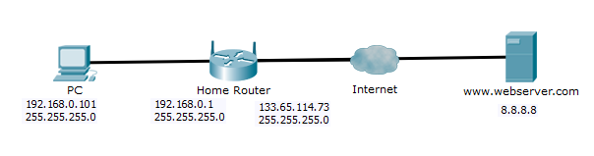
Gateway address
A device on a network can only communicate with other devices on the same network
A gateway is a router that has an address on the same network your device is on and another address on a different network.
To send packets to a different network you need to first send them to your local gateway.

Slide 9
Gateway Address
Notice the Network ID of the PC and the Home Router (inside) are the same
If your PC needs to send data to another host is first uses its own subnet mask to determine if the destination IP is on the same network:
If it is, then the data is sent directly to the destination
If it is not, then the data is sent to the gateway which will forward it along the path to its final destination

Slide 10
DNS – Domain Name System
All hosts on the Internet require IP addresses
The DNS is basically the phone book for the Internet
It keeps a list of FQDN Fully Qualified Domain Name)and associated IP addresses , like google.com -> 192.168.1.10
Allows a user to enter a easy to remember name and reach a Internet resource
EX: www.google.ca – when this is entered into you web browser you local DNS process sends out a request to find the IP and then your browser connects to the return IP address
Try: Open a cmd prompt on your PC and type ping www.google.ca
Notice that you see the IP address of www.google.ca
Try: ping blackboard.algonquincollege.com
Try this from the college and from home. Are the results the same?

Slide 11
NAT – Network Address Translation
The supply of IPv4 address has been exhausted
NAT is used to allow networks to use private IP addresses internally and public IP addresses externally
There are two types of NAT
Static - One to one – where each internal private IP is mapped to one external public IP
Dynamic - Many to one (or a pool) – every connection from an internal private IP is mapped to a shared external public IP. This requires keeping track of more than just the IP address of the source

Slide 12
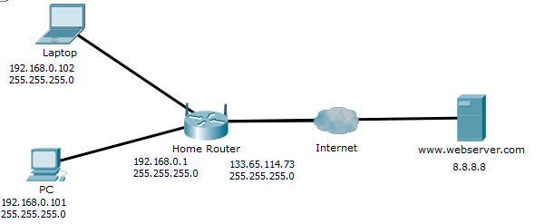
Static NAT
Inside Private | Outside Public
192.168.0.101 | 133.65.114.71
192.168.0.102 | 133.65.114.72

Slide 13
Dynamic NAT
Inside Private | Outside Public | Client Port
192.168.0.101 | 133.65.114.75 | 1025
192.168.0.102 | 133.65.114.75 | 1026

